Slide 1
Local Fiscal Recovery Fund Allocations
June 9, 2021

Slide 2
Objectives
American Rescue Plan Act Allocations
Treasury Interim Rule
Distribution Process
Using the Web Portal
Reporting Requirements
Questions and Answers

Slide 3
American Rescue Plan Act
The American Rescue Plan Act (ARPA) provides $350 billion for eligible state, local, territorial, and Tribal governments to mitigate the fiscal effects of the COVID-19 emergency.

Slide 4
American Rescue Plan Act
ARPA established the Coronavirus State Fiscal Recovery Fund for state allocations.
ARPA also established the Coronavirus Local Fiscal Recovery Fund (CLFRF) for local government allocations.
The Coronavirus State and Local Fiscal Recovery Funds provide flexibility for each government to meet local needs as detailed in federal guidance.

Slide 5
California’s Allocations
State: $26 billion
Counties: $7.7 billion
Metropolitan Cities: $7 billion
Small Cities (population under 50,000): $1.2 billion
States, counties, and metropolitan cities will receive their allocation directly from the U.S. Treasury.
The state is required to disburse allocations to the 291 small cities or non-entitlement units of local government (NEU).

Slide 6
U.S Treasury Interim Rule
Funding is subject to the requirements specified in the Interim Final Rule published by the U.S. Treasury in the Code of Federal Regulations on May 17, 2021.
Comments must be received by July 16, 2021.
The allocation methodology, distribution process, and reporting requirements are based on the U.S. Treasury’s Interim Rule, Guidance, and Treasury FAQs.
The state’s role in this process is ministerial in nature.
Each recipients is responsible for adhering to the U.S. Treasury’s requirements for expending and reporting on this funding.

Slide 7
State Responsibilities
Calculate initial allocations –Based on each city or town’s share of the eligible population (using data provided by Treasury based on 2019 U.S. Census data)
Establish a process to accept/decline funds
Collect required documents/information, including top-line budget information for Interim Federal Report in August
Verify no entity exceeds the 75-percent cap
Disburse initial payments, apply for extensions if needed
Direct recipients to all federal requirements
Facilitate Treasury communications with NEUs

Slide 8
Eligible Usages
Respond to the COVID-19 public health emergency and support various activities to decrease the spread of the virus
Address negative economic impacts caused by the public health emergency
Replace lost public sector revenue due to the pandemic
Provide premium pay to eligible workers or grants to eligible employers of essential workers
Invest in water, sewer, and broadband infrastructure.
Funds must be obligated by December 31, 2024, and expended by December 31, 2026

Slide 9
Additional Federal Information
Treasury Interim Final Rule: https://www.govinfo.gov/content/pkg/FR-2021-05-17/pdf/2021-10283.pdf
Treasury FAQs: https://home.treasury.gov/system/files/136/SLFRPFAQ.pdf
Treasury Factsheet: https://home.treasury.gov/system/files/136/SLFRP-Fact-Sheet-FINAL1-508A.pdf
Federal Rulemaking ePortal: https://www.regulations.gov/document/TREAS-DO-2021-0008-0002

Slide 10
State Certification – Accept $
To accept funds, cities and towns must use the state ‘s web form to provide the following information:
Taxpayer ID, DUNS Number, and contact information
Signed Certification Form
Total annual operating budget in effect as of January 27, 2020 or top-line expenditure total
Signed Award Terms and Conditions form
Signed Assurances of Compliance with Title VI of the Civil Rights Act of 1964
The state will use existing banking information for disbursements and does not need to collect this from cities

Slide 11
State Certification – Decline $
If a city plans to decline funds, cities and towns must use the state’s web form to provide the following information:
Contact information
Signed Certification Form
Federal Form to Deny Funds (as required)
The state may contact any city/town that declines funds and will notify the Joint Legislative Budget Committee. Declined funds cancel the NEU award and transfer to the State.
Non-Responsive Cities: The state must make reasonable attempts to contact these cities and wait at least 60 days before reallocating funds to other cities and towns (budget cap applies)

Slide 12
Distribution Process
Submissions are due no later than 11:59 p.m. on June 23, 2021. Payments will likely be delayed if your application is received after this date.
An entity’s allocation cannot exceed 75% of its most recent budget as of January 27, 2020.
Allocations will be revised before disbursement if the entity’s allocation exceeds the 75% cap.
The state must return any amount that exceeds the cap to Treasury.

Slide 13
Distribution Process
Treasury will make payments to states in two tranches.
First disbursement: After state receipt (likely 6/16/21). This is the date that begins the first 30-day allocation timeline.
Second disbursement: 12 months later.
The state completed the Joint Legislative Budget Committee notification (6/3/21) for authority to accept/disburse funds.
After reviewing the submissions, the Department of Finance will coordinate with the State Controller’s Office to process payments to eligible cities and towns.

Slide 14
Poll Question #1
Does your city plan to accept or decline the federal Coronavirus Fiscal Recovery Funds?
Yes
No
Undecided

Slide 15
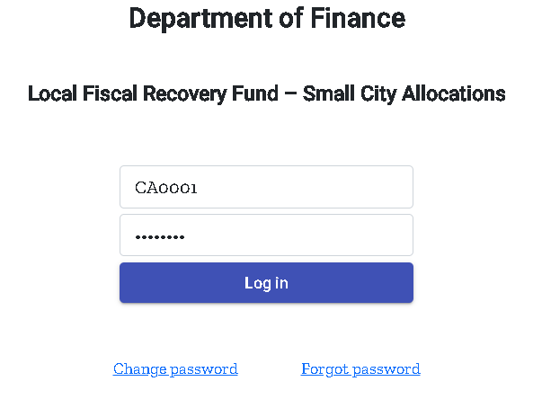
Accessing the Web Portal
Optimized for the Google Chrome web browser
Each eligible city and town will be emailed a unique “NEU Recipient Number” and password to access the required web form.
The NEU Recipient Number must be retained by the city or town as it will be used for the reporting to Treasury through the lifecycle of the program.

Slide 16
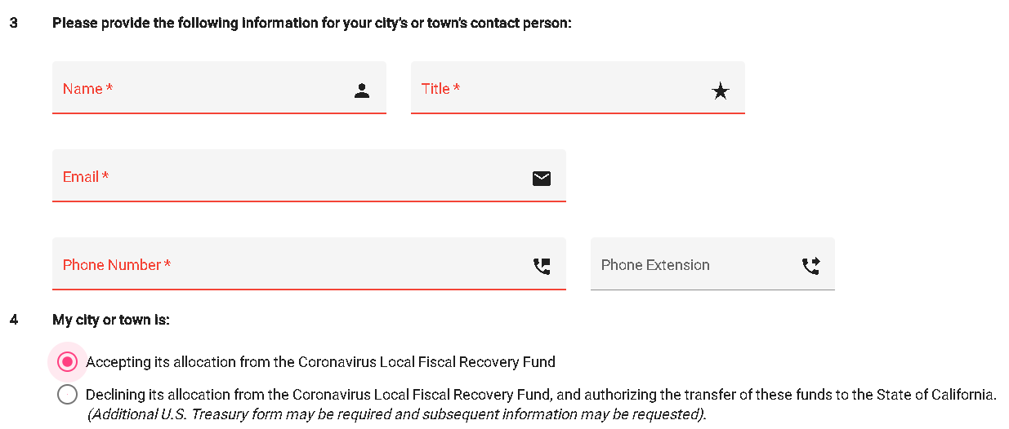
Web Portal: City Information
Contact Information
Accept or Decline Funds
Tax ID Number
DUNS Number

Slide 17
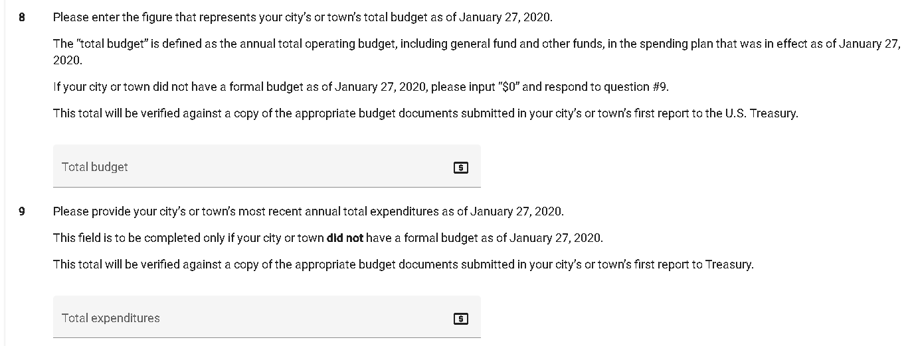
Web Portal: Budget Information
Total annual operating budget, including general fund and other funds, in effect as of January 27, 2020
Expenditure total, in exceptional cases in which a city or town does not adopt a formal budget

Slide 18
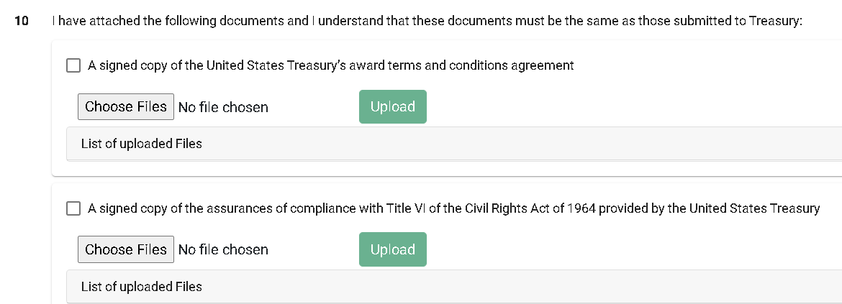
Web Portal: Sign and Upload
Awards and Conditions Agreement
Assurances of Compliance with Title VI of the Civil Rights Act of 1964
Certification Form
Copy of most recent top-line operating budget or annual total expenditures as of January 27, 2020
Files may not exceed 40Mb

Slide 19
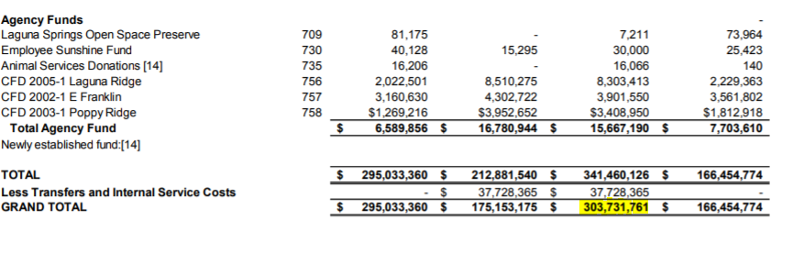
Example of Budget Document
Please highlight the figure that you are reporting as your total annual operating budget or top-line expenditure total.

Slide 20
Web Portal: Certify and Submit
Confirmation e-mail to confirm receipt of the submission.
Save: Allows saving “in progress” entries and return at a later time.
Submit: All required documents must be upload and fields must be complete to certify and submit.
If you need to make changes after data is submitted, please email FiscalRecovery@dof.ca.gov

Slide 21
Web Portal: Error Messages
You will not be able to submit the web form if you are missing information including required documents to be uploaded.
You will receive a pop-up box listing the missing information.

Slide 22
Poll Question #2
When will your city submit the application/ certification to the state to accept or decline the federal Coronavirus Fiscal Recovery Funds?
In one week or less (recommended)
By the due date (June 23, 2021)
After the due date

Slide 23
U.S. Treasury Reporting Requirements
Small cities and towns are required to submit a project and expenditure report to Treasury annually on the use of funds.
In addition to other reporting requirements, small cities and towns will be asked to provide:
NEU Recipient Number
Copy of signed Award Terms and Conditions Agreement
Copy of signed Assurances of Compliance with Title VI of the Civil Rights Act of 1964
Copy of budget documents

Slide 24
U.S. Treasury Reporting Requirements
First Annual Report: Due to Treasury by October 31, 2021.
Ongoing reports will be due by October 31 every year.
All financial records and supporting documentation must be retained for five years after all funds have been expended.
Reporting guidance from the U.S. Treasury has not been released.
When available, we will post additional guidance on the Finance webpage and send an e-mail notice to provided contacts.

Slide 25
Requirements May Differ from CRF
Per Treasury FAQs, many expenses authorized under the Coronavirus Relief Fund (CRF) are also eligible uses of these funds.
Cities are Prime Recipients, not sub-recipients
Recipient must review guidance carefully.
Cities cannot rely on the state to interpret federal guidance.
Treasury e-mail: SLFRP@Treasury.gov

Slide 26
Requirements May Differ from CRF
Some notable exceptions…
Public health/safety staff can be considered “entirely devoted” to mitigating/responding to COVID:
More than ½ the employees time must be primarily dedicated to responding to COVID.
Revenue replacement allowed. Recipients must follow Treasury formula/guidance to demonstrate.
Funds cannot be used as the non-federal match in other programs (FEMA public assistance).
Longer obligation and expenditure timelines.

Slide 27
Questions/Follow-Up
Questions on the Distribution Process and Web Portal:
FiscalRecovery@dof.ca.gov
U.S. Treasury Interim Rule:
https://www.govinfo.gov/content/pkg/FR-2021-05-17/pdf/2021-10283.pdf
U.S. Treasury FAQs: https://home.treasury.gov/system/files/136/SLFRPFAQ.pdf
Department of Finance webpage:
https://dof.ca.gov/budget/COVID-19/Local_Fiscal_Recovery_Fund_Allocations/
Notes:
There is a lot to sort through and digest, so our contacts are dedicated in boxes are provided here as well as link to federal guidance and information. Not all is intuitive/easy to find.
As noted previously, I frequently will go to the federal website and use “Control + F” to search for specific questions that come up.

