Slide 1






California Statewide Local Streets & Roads Needs Assessment
2014 Update
RTPA
RCTF

Slide 2
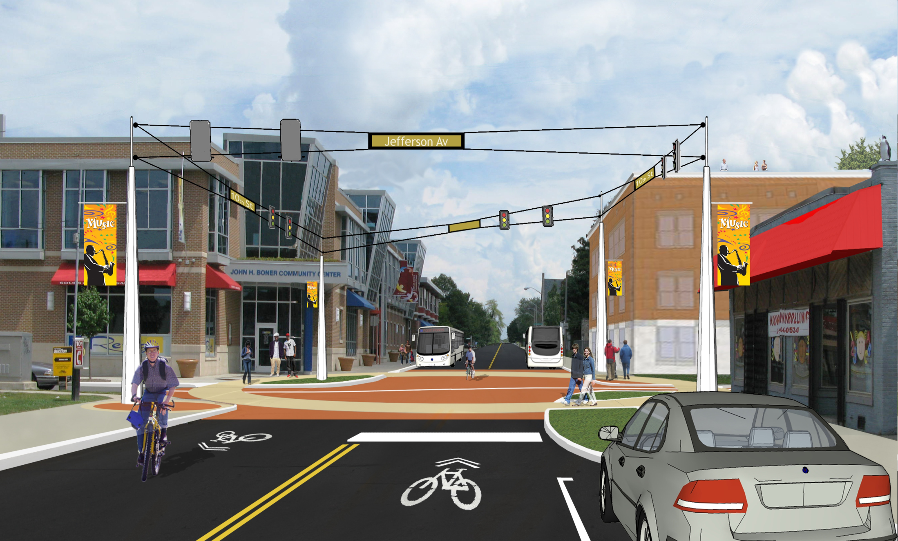
Background
Air &
GHG
What are pavement conditions statewide?
How much will it cost to maintain pavements? Bridges? Essential components?
What is the funding shortfall?
What is impact of different funding scenarios?
Alt.
modes
Noise
Energy
Storm water

Slide 3
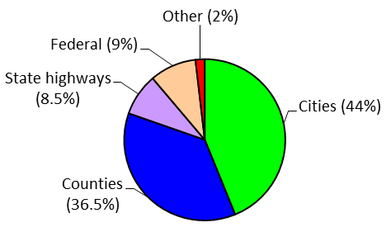
Local Roads Are Huge Part of California’s Network
More than 80% of California’s roads are owned by cities & counties!

Slide 4
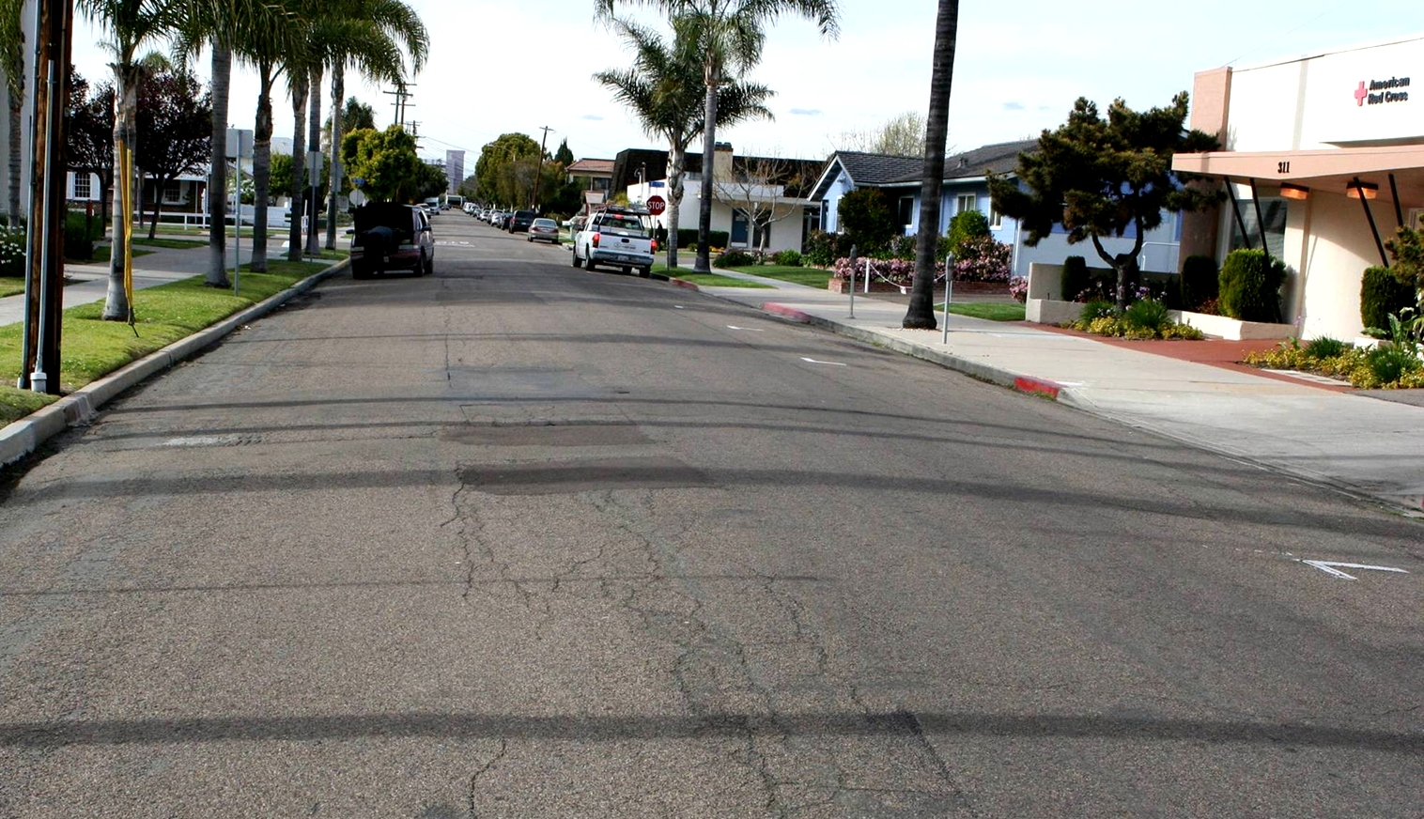
Pavements

Slide 5
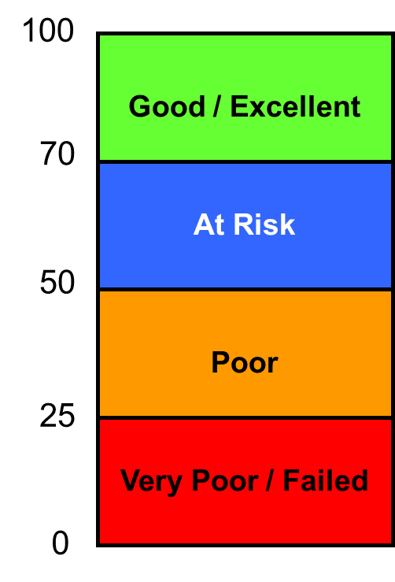
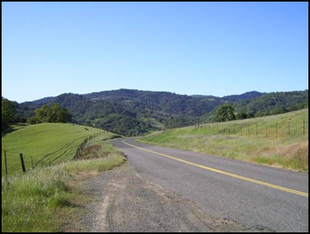
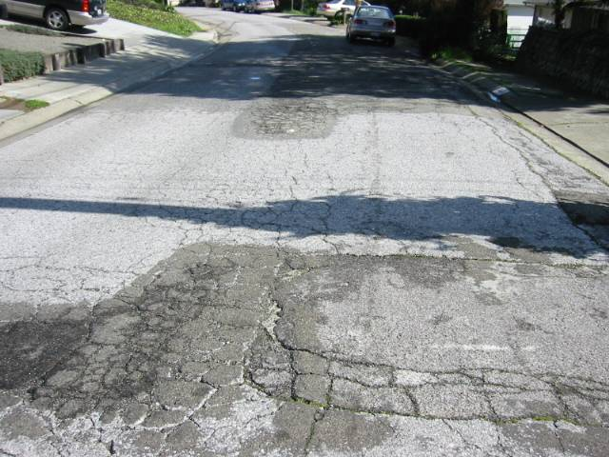
Average Pavement Condition Index
68 (2008)
66 (2014)
Urban major = 68
Urban minor = 66
Rural major = 67
Rural minor = 57

Slide 6
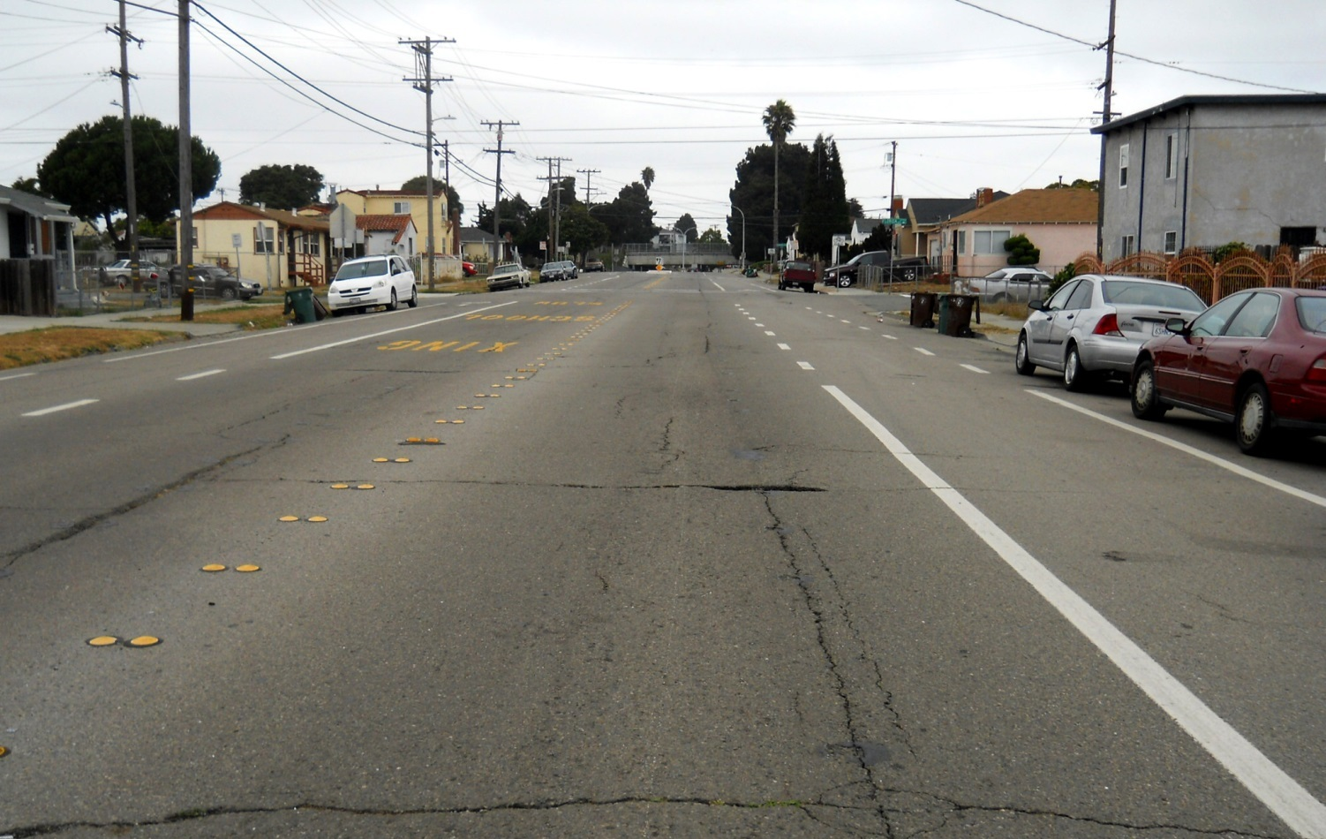
Statewide Average PCI = 66
This doesn’t look too bad…

Slide 7
So Why is 66 Critical?
100
$2-4/sy
70
66
$15-20/sy
PCI
50
$30-40/sy
25
$70-100/sy
0
Time (years)

Slide 8
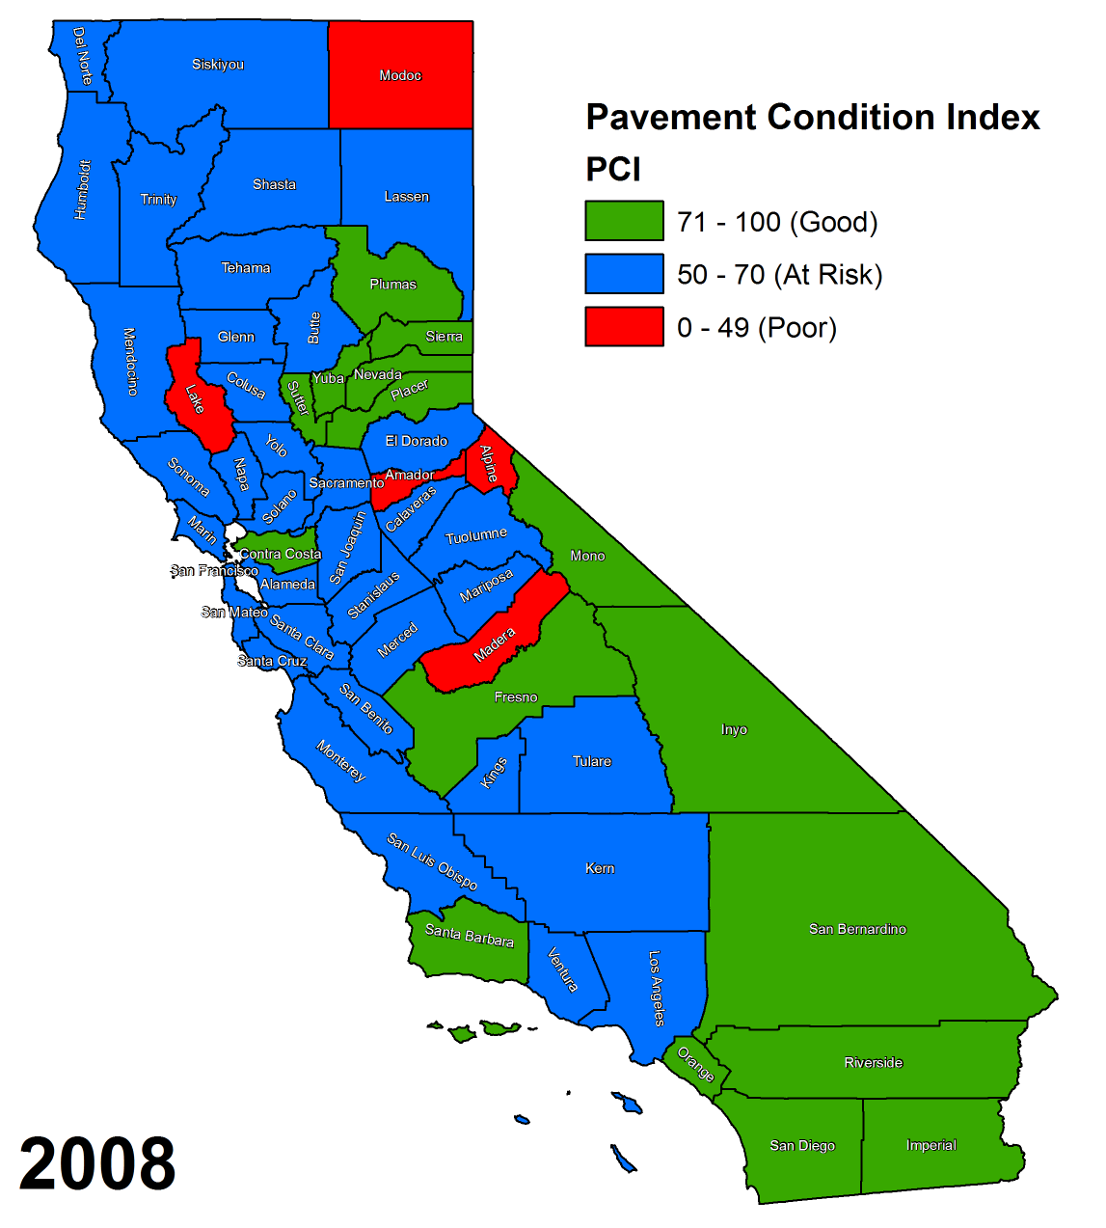
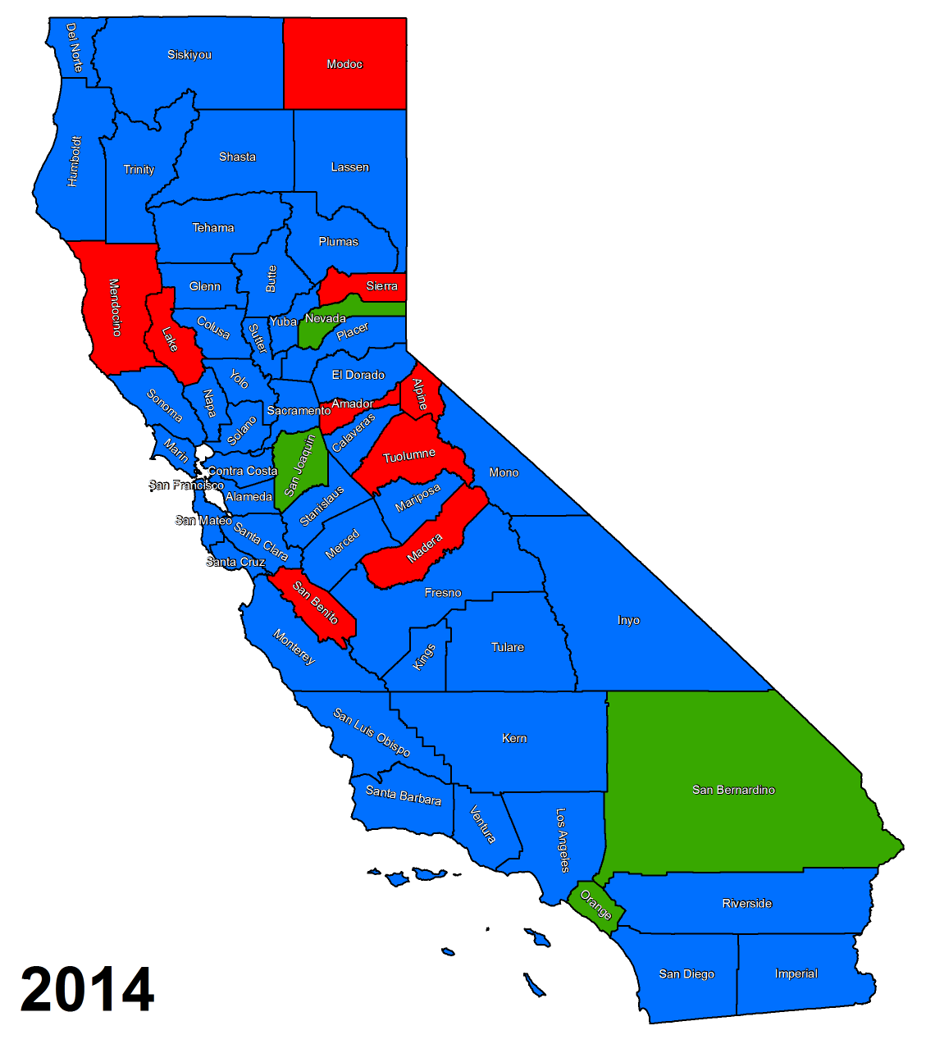
PCI Trends

Slide 9
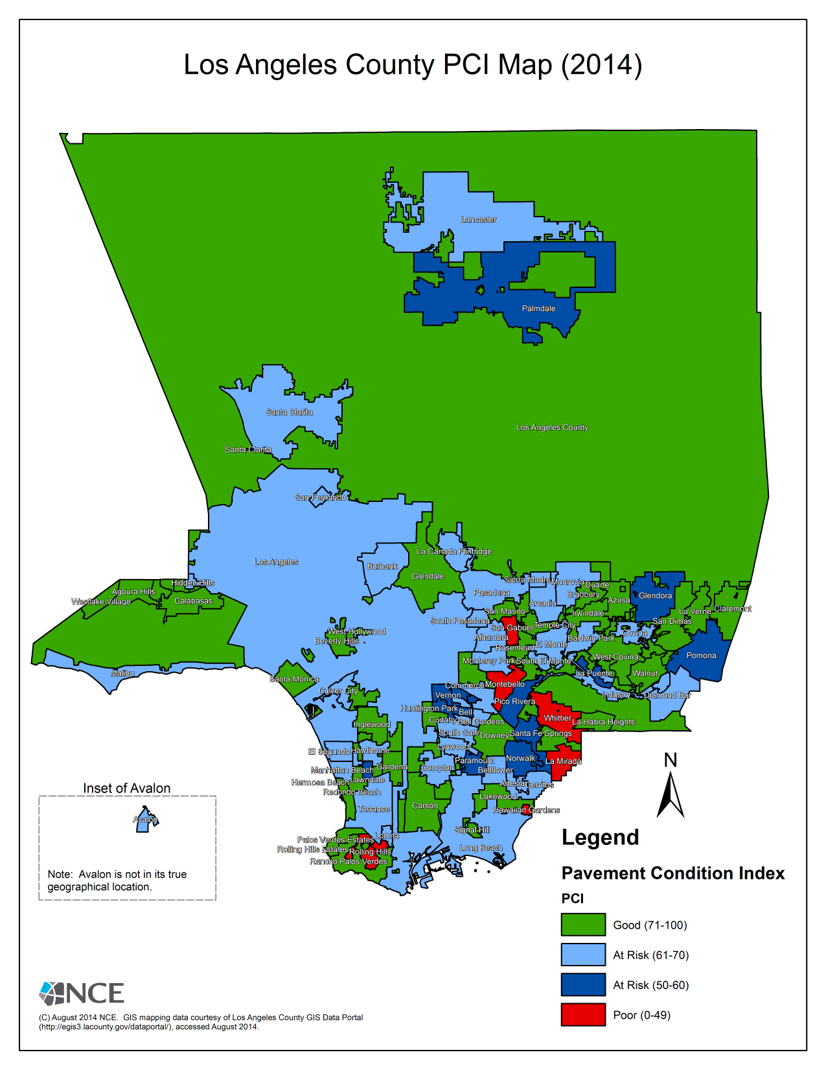
2014 Report – New Details
Report and website will include maps for all counties
Maps depict PCI down to city level
Notes:
Can be deleted

Slide 10
Condition of [CITY/COUNTY]
Local Roads
City/County has an average PCI of ____.
This is up/down from ____ in 2012.
Insert other City/County specific details on the condition of your local street and road system.

Slide 11
Funding Strategies for Pavements
RTPA
RCTF

Slide 12
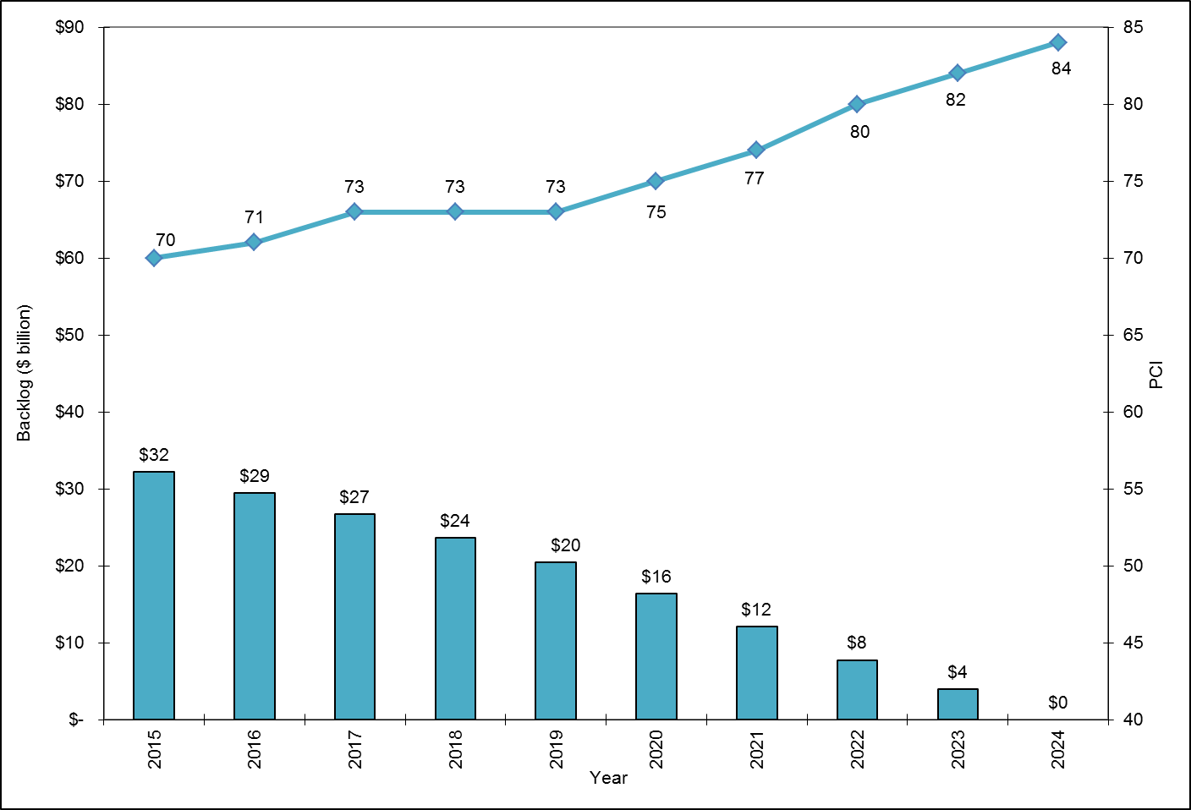
Reach Best Mgmt Practices ($7.3 B/year)

Slide 13
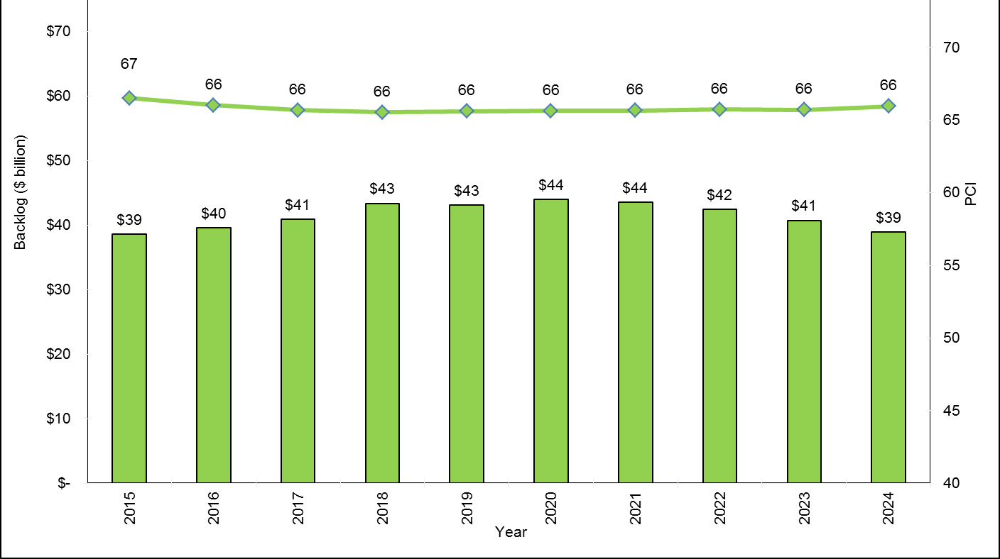
Maintain PCI = 66 ($3.3 B/year)

Slide 14
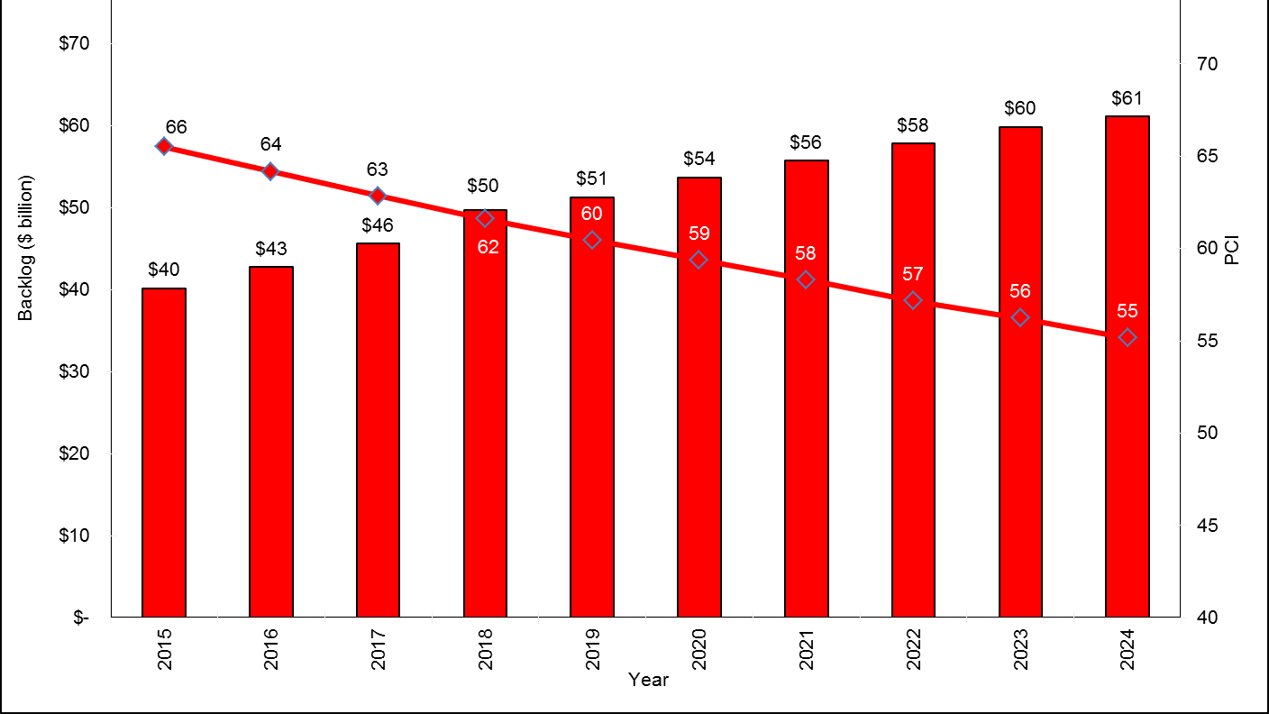
Existing Funding ($1.66 B/year)

Slide 15
Sustainable Pavement Strategies
If just half of eligible projects use CIR/FDR, we can save $900 million/year!
Notes:
60% of agencies reported using sustainable pavement strategies
Savings up to 35%

Slide 16
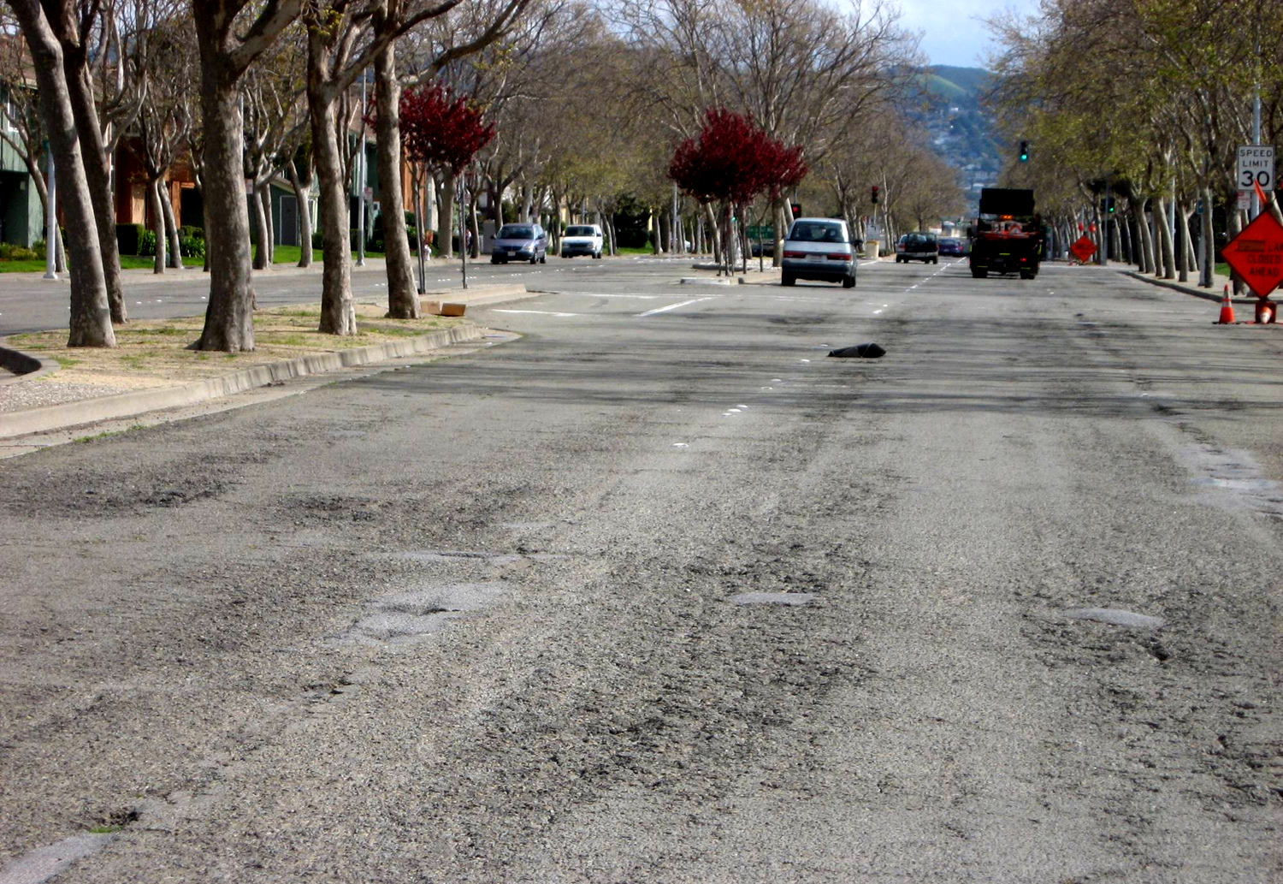
What Happens without New Funding?
The percent of roads in failed condition will increase from 6.2% to almost 25% by 2024 under current funding

Slide 17
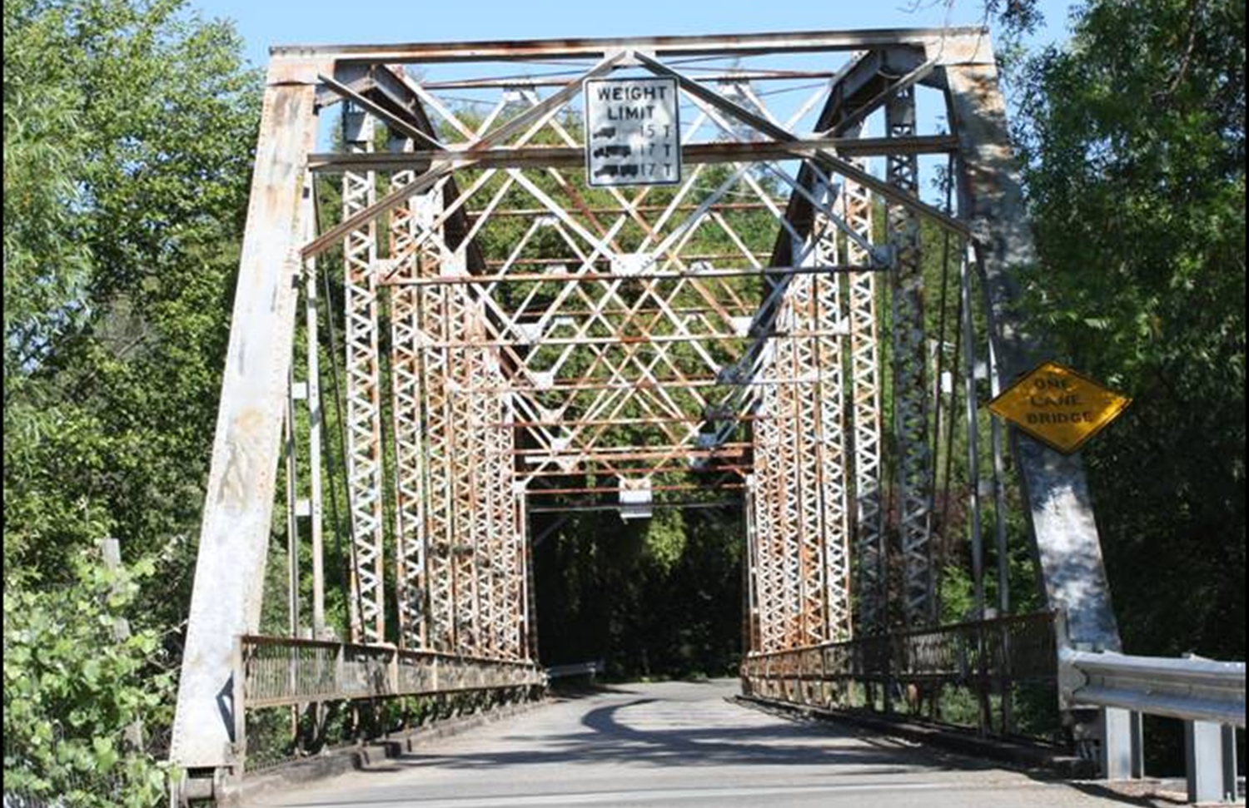
Local Bridges

Slide 18
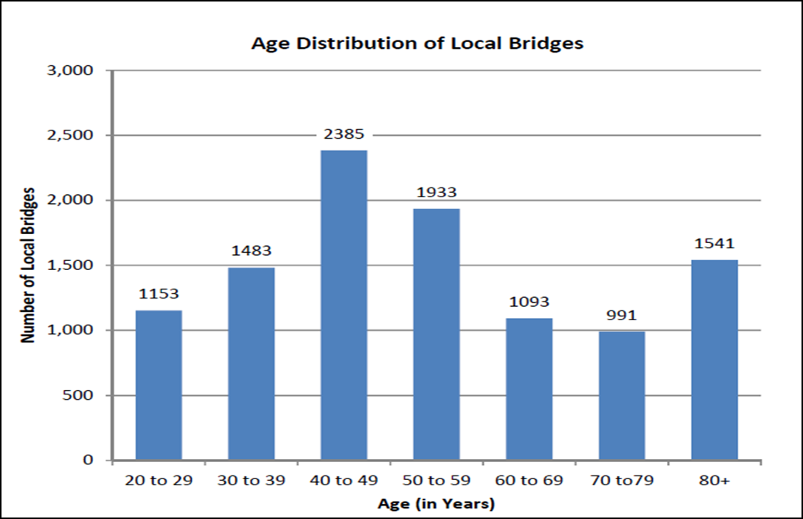
Bridges Are Getting Old
55% require rehabilitation or replacement

Slide 19
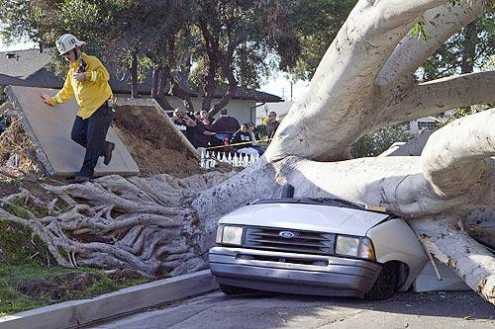
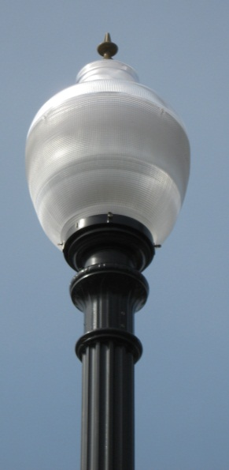
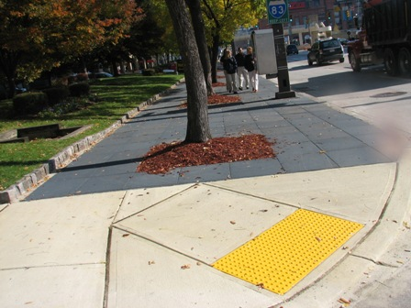
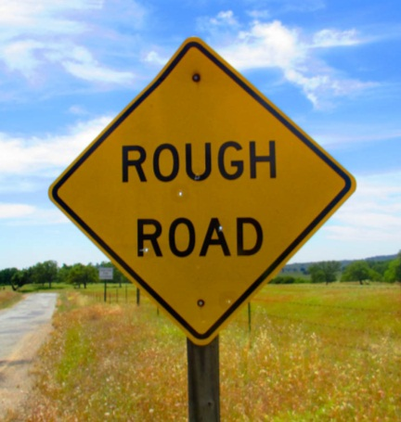
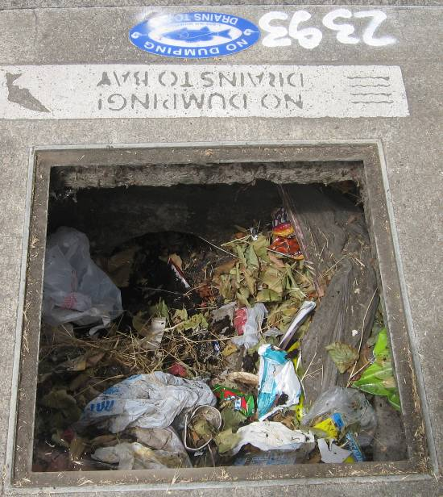
It’s Not Just Roads and Bridges
Sidewalks
Curb ramps
Curb & gutter
Storm drains
Street lights
Signs
Retaining walls
Notes:
Storm drains
Curb and gutter
Sidewalk
Curb ramps
Traffic signals
Street lights
Sounds walls/retaining walls
Traffic signs
Other categories
NPDES
ADA
Others

Slide 20
What Are Funding Shortfalls?
Transportation Asset | 10 Year Needs (2014 $B)
Pavements | $72.7
Essential Components | $31.0
Bridges | $4.3
Totals | $108.0
Funding
$16.6
$10.1
$3.0
$29.7
Shortfall
$ (56.1)
$ (20.9)
$ (1.3)
$ (78.3)

Slide 21
Funding Shortfall for [CITY/COUNTY]
City/County has a funding shortfall of ____.
City/County has a backlog of ____.
This is up/down since 2012. Why?
Other City/County specific details on the financial needs of the system.

Slide 22
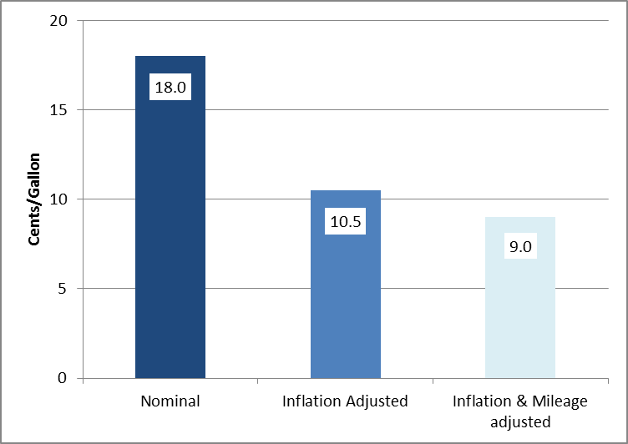
Value of Gas Tax in 2014
From: Caltrans Division of Budgets

Slide 23
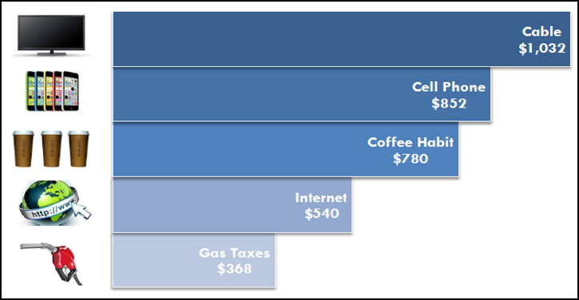
Existing Gas Tax Compared with Other Items ($/year)
From: Caltrans Division of Budgets

Slide 24
Potential Funding Solutions
Potential Solutions | Savings/Revenues ($M/year)
New technologies to stretch existing dollars | $ 912
Restore gas tax to 1994 levels | $ 1,700
Index gas tax to CPI (2%) | $ 48
Raise gas tax by 10 cents/gallon | $ 1,330
Return weight based fees | $ 950
Mile-based fee (SB 1077) | Unknown

Slide 25
Findings
Local road network is deteriorating, and by 2024:
  Average PCI will deteriorate from 66 to 55
  Unfunded backlog will grow to from $40 to $61 billion
  Almost 25% of roads will be in failed condition
  Similar conclusions for bridges, safety and other essential transportation components
An additional $7.8 billion/year is needed

Slide 26
Conclusions
Californians and our economy relies on the local transportation system
New sustainable sources of revenues must be created that are focused on preservation of existing local road network
Californians need to work together to find ways to fund local streets & roads

Slide 27
Questions?
RTPA
RCTF

