Slide 1
League of Cities – Riverside Division
Elected Official Training
February 3, 2017
Hasan Ikhrata, Executive Director
Southern California Association of Governments

Slide 2
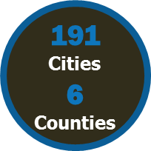
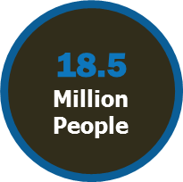
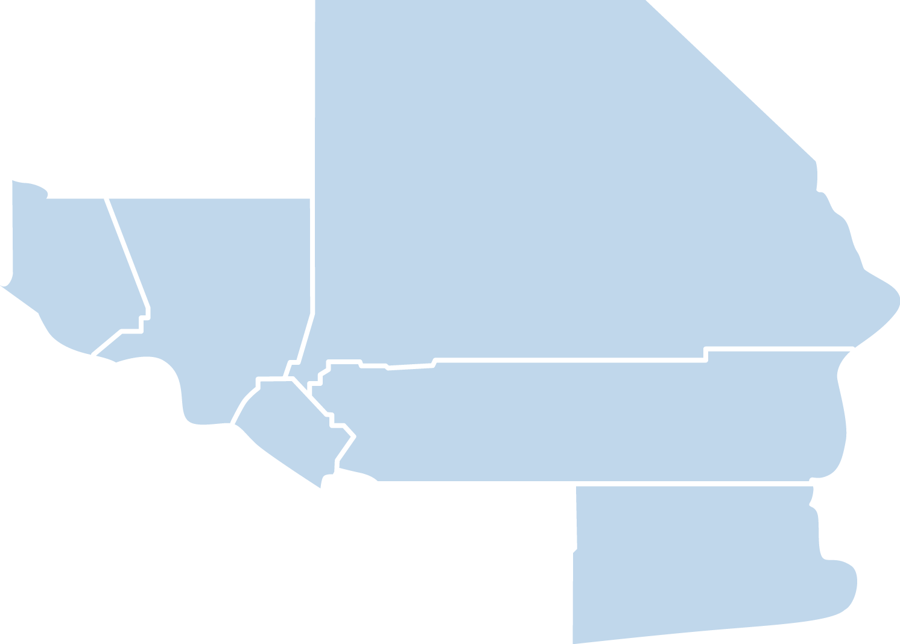
What is SCAG?
Nation’s Largest Metropolitan Planning Organization (MPO)
38,000 Square Miles
Nation’s Global Gateway for Trade
Develops the Region’s Long-Range Transportation Plan (RTP/SCS)
SAN BERNARDINO
VENTURA
LOS ANGELES
ORANGE
RIVERSIDE
IMPERIAL

Slide 3
SCAG Deals with these Regional Issues
Notes:
SCAG is a convener and regional facilitator for these issues, but is also required to address numerous mandate. Most notably RHNA and RTP/SCS.

Slide 4
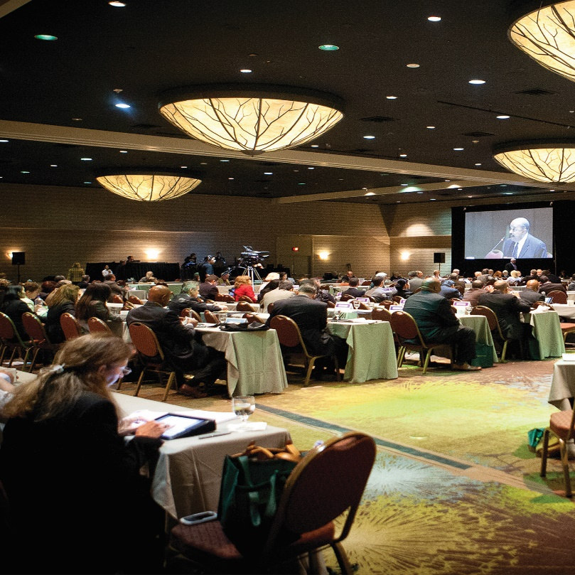
SCAG’s Governance Structure
General Assembly
Representative from each member jurisdiction
Meets once a year (public meeting)
Regional Council
Comprised of 88 members (local elected officials and one private sector representative)
Meets once a month (public meeting)
Sets policy direction for the agency
Policy Committees
3 major policy committees
Meets once a month (public meeting)
Makes policy recommendations to the Regional Council

Slide 5
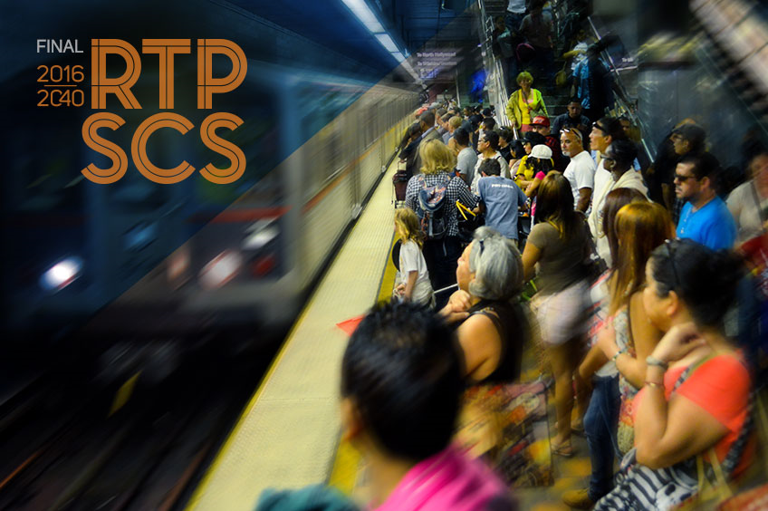
SCAG Member Benefits
Voice in Regional Planning
Funding Opportunities
Transportation
Advocacy
Data, GIS & Modeling
Library of Regional Studies

Slide 6
2016 RTP/SCS – Adopted April 7, 2016
What?
Why?
Long-term Vision and Investment Framework
Federal Requirement
Updated every 4 years to maintain eligibility for federal funding
Long Range: 20+ years into the future
Financially-constrained: Revenues = Costs
Passes regional emission standards (Conformity)
State Requirement
Must meet SB 375 requirements (address GHG reductions)
Transportation knows no boundaries
Coordinate regional projects
Facilitates regional/local competitiveness for funding
Integrates transportation investments and land use strategies
Allows any federally-funded or regionally-significant projects to maintain their eligibility for federal funding
Notes:
RTP Overview

Slide 7
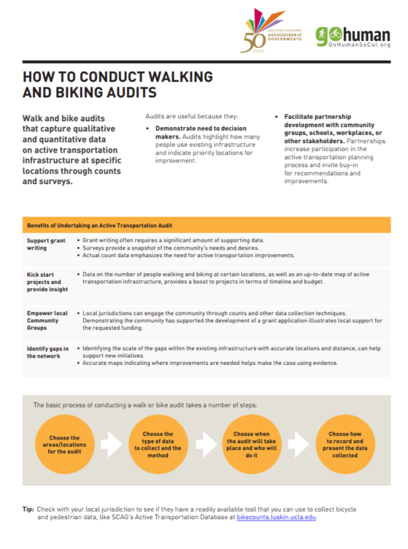
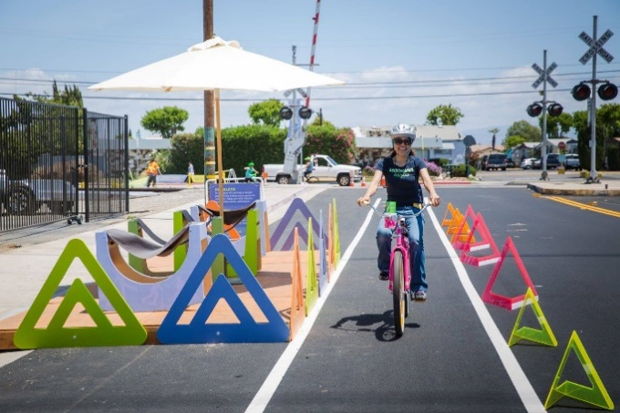
Go Human Campaign
Advertising Campaign
Toolkits/ Trainings
Open Streets & Temporary Events
Notes:
The campaign consists of regional advertising, Go Human events, and training activities.
Ads
Ads were developed to respond to most common causes of collisions in Southern California.
Ads target people driving, walking and biking.
Cities are welcome to use and co-brand any of the materials developed through the campaign.
SCAG can help with resizing images for street banners or other advertising spaces managed by the city/county.
SCAG ran the campaign in Fall 2015 and will re-run it in May 2017 with some new artwork.
Toolkit
Online resources with fact sheets and training materials to increase awareness and promote walking and biking
Go Human Events: Open Streets and Temporary Events
Short-term demonstration projects that allow communities to re-envision streets for walking and biking through temporary installation of active transportation infrastructure. Events can last 1-day to 1-month. Events also include bike trainings and educational activities to increase awareness of rules of road and encourage more walking and biking.

Slide 8
Thank you!
Learn more by visiting http://www.scag.ca.gov.

